Slide 1

Lesson 4: Boot Loading
AMS
Applied Microcontroller Systems
Version: 5-2-2017, Henning Hargaard

Slide 2
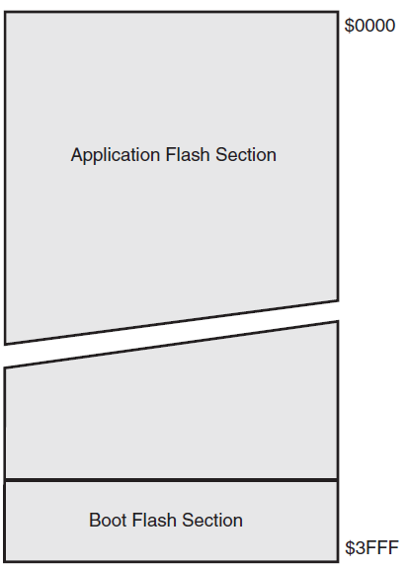
Mega32 Program Memory

Slide 3
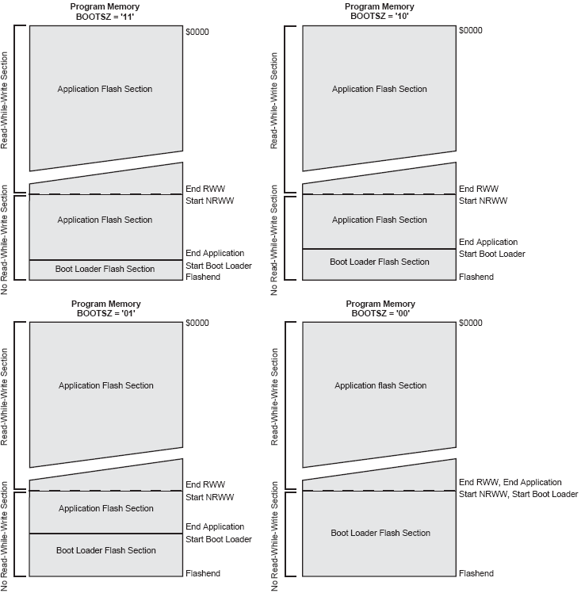
Selectable Boot Section Size (Fuses)

Slide 4
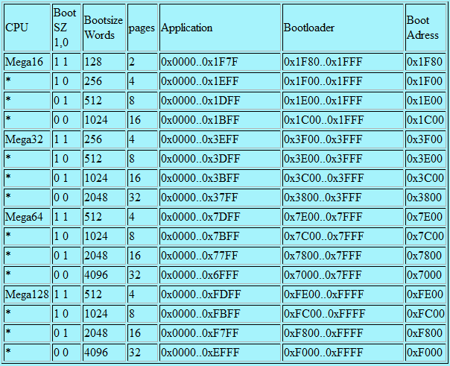
Bootblock Size

Slide 5
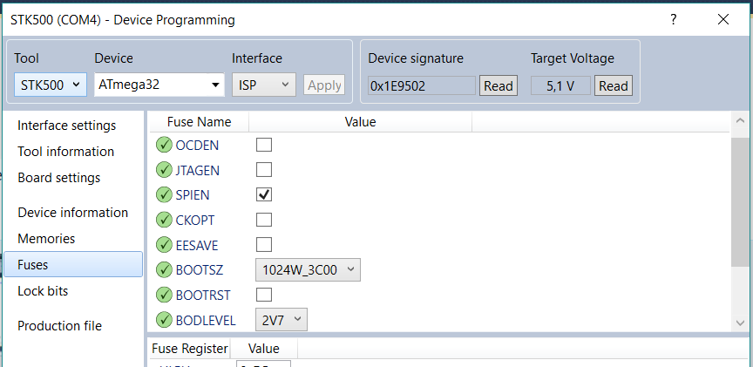
Atmel Studio: Setting Bootblock Size

Slide 6
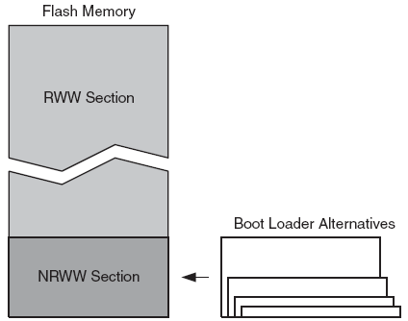
RWW and NRWW Sections

Slide 7
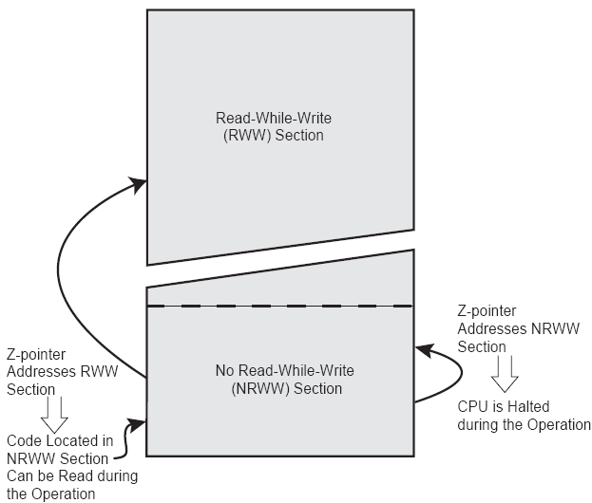
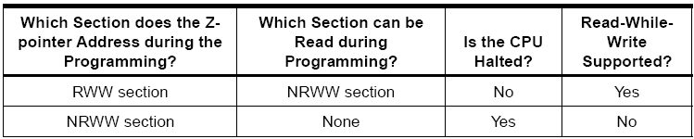
RWW and NRWW differences

Slide 8
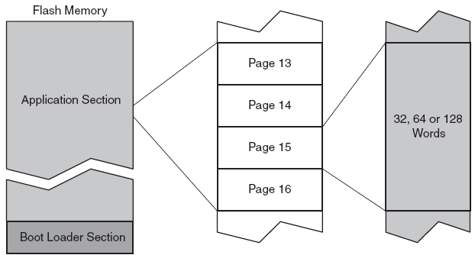
Program Memory Paging
Mega32: 64 Words / Page
(= 128 Bytes / Page ).

Slide 9
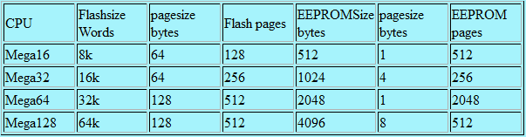
Page Size

Slide 10
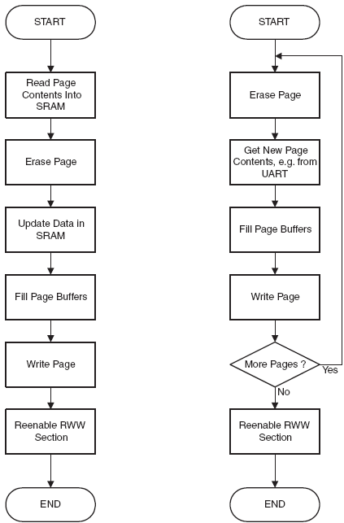
Typical Update Procedures
( Read-Modify-Write )
Page Write

Slide 11
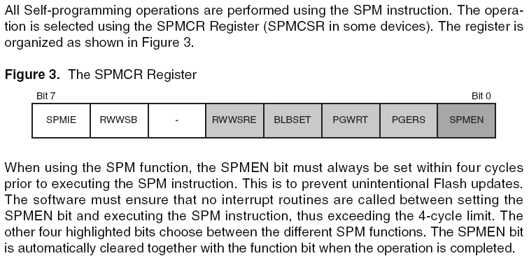
Using the SPM instruction
Inline assembly (AVR GCC):
__asm(”SPM”);

Slide 12
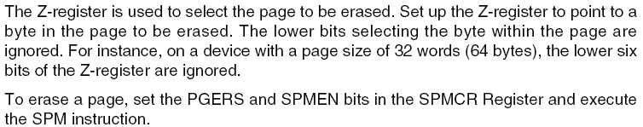

Page Erase

Slide 13
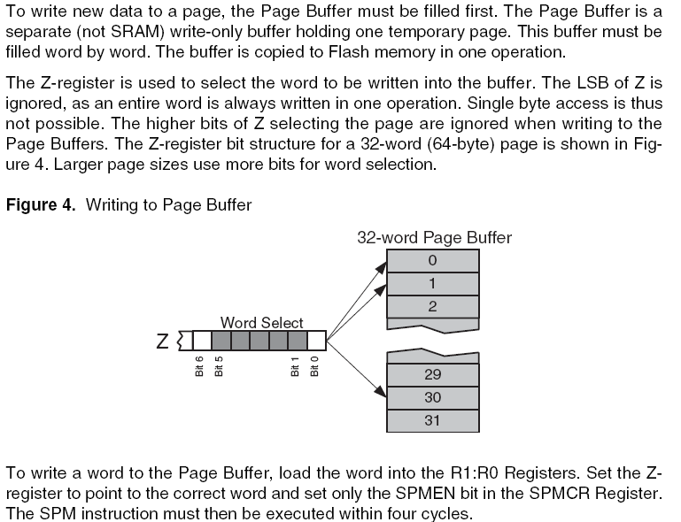
Loading Page Buffer

Slide 14
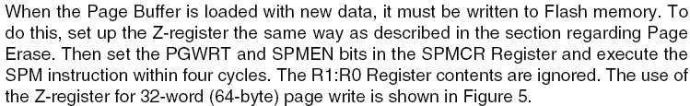
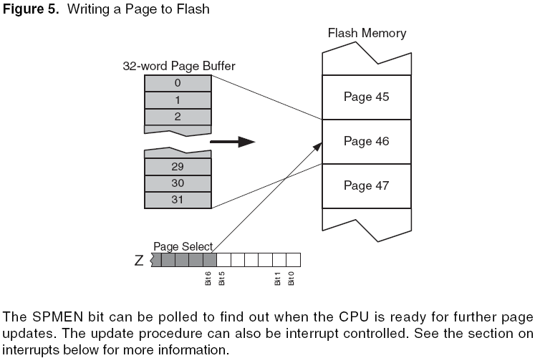
Page Write

Slide 15
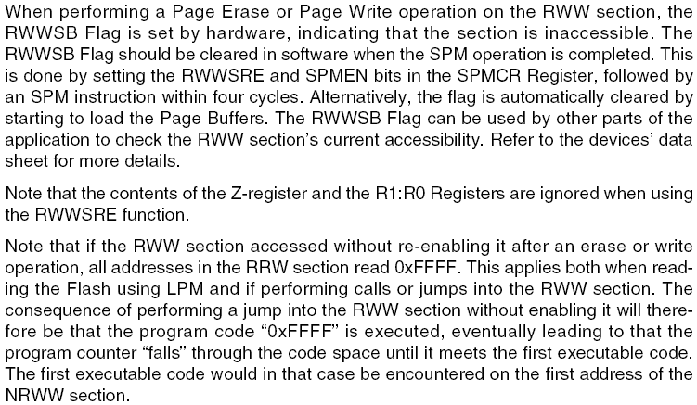

The RWW Section Busy Flag

Slide 16
Avoid EEPROM Conflicts

Slide 17
Typical Update Procedures
Read-Modify-Write
Page Write

Slide 18
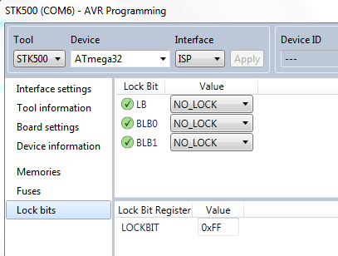
Atmel Studio: Mega32 Lock Bits

Slide 19
Atmel Studio: Mega32 Reset Fuse
If BOOTRST set: Program execution starts in Boot Loader.
If BOOTRST not set: Program execution starts in application (0).

Slide 20
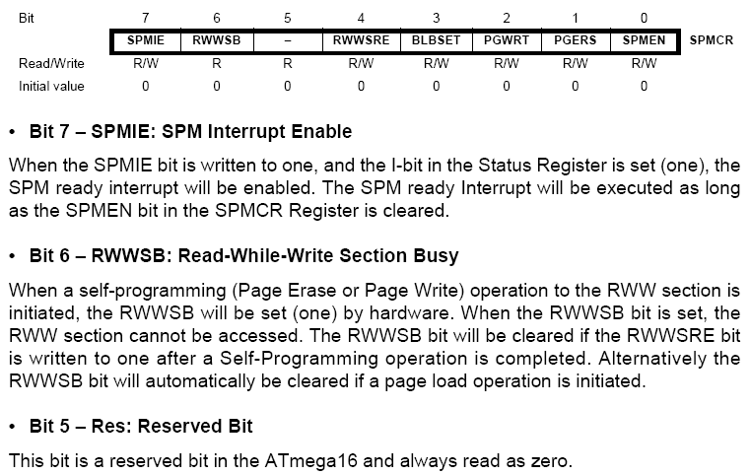
Store Program Mem. Control Register

Slide 21
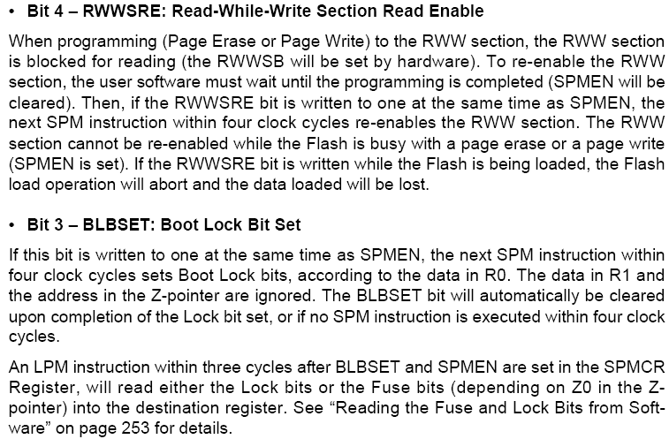
Store Program Mem. Control Register

Slide 22
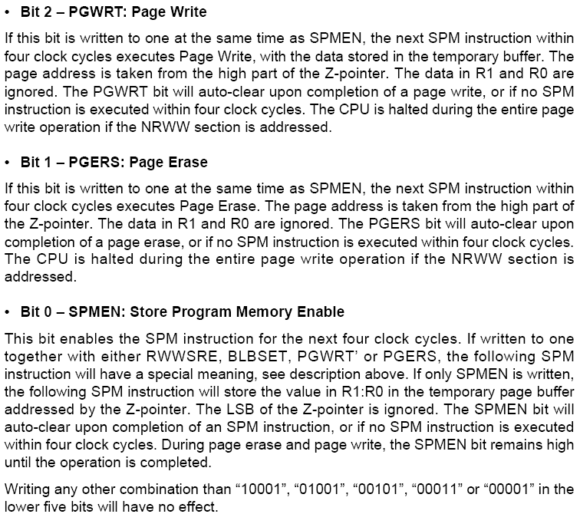
Store Program Mem. Control Register

Slide 23
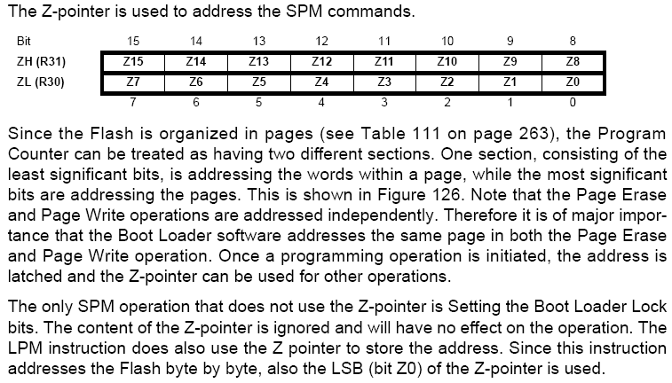
Addressing the Flash

Slide 24
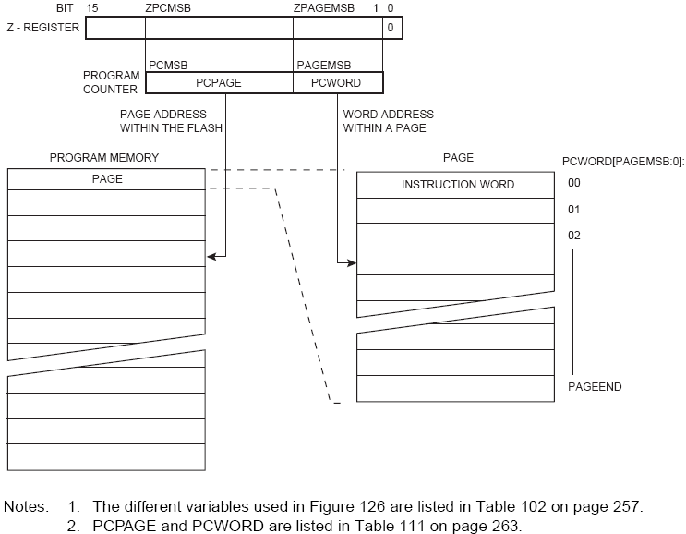
Addressing the Flash (Mega32)
← Consult next slide !

Slide 25
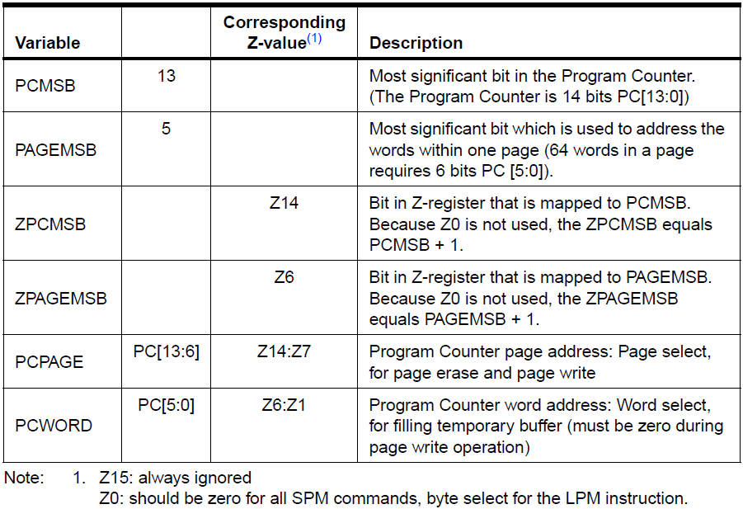
Addressing the Flash (Former Slide)

Slide 26
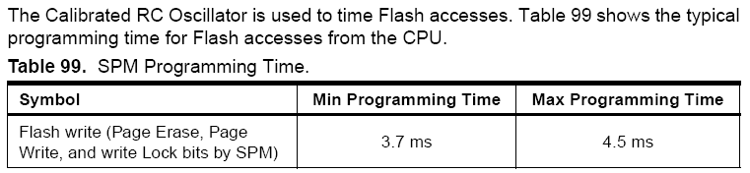
Flash Programming Time

Slide 27


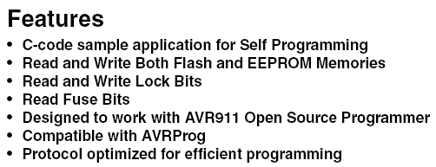
AVR109: Self Programming
Available at AMS Blackboard

Slide 28
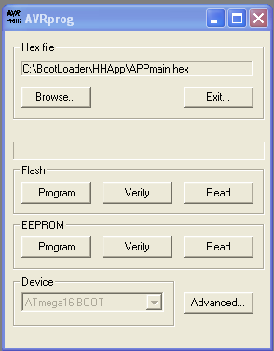
AVR Prog (version 1.40)
IMPORTANT:
Use only COM ports:
COM1
COM2
COM3
COM4
Problems?
Try COM setting: ”FIFO” = 1.
The ”AVR Prog” is available at AMS Blackboard.

Slide 29
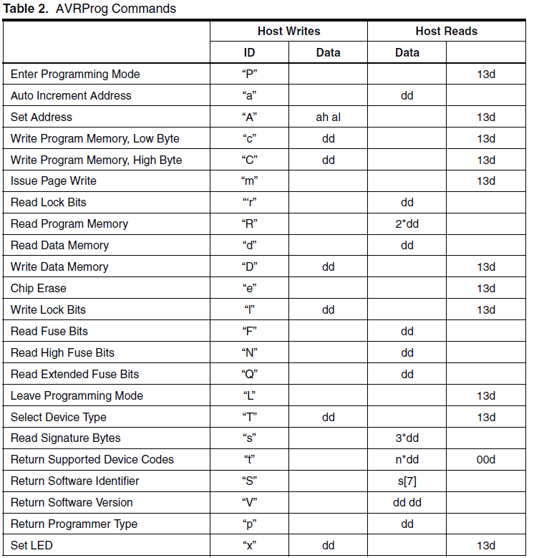
”AVR Prog”, Protokol (1 of 2)

Slide 30
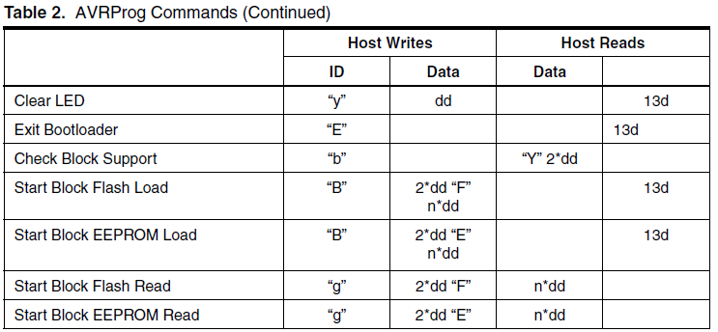
”AVR Prog”, Protokol (2 of 2)
More informations:
See the AVR109 application note and/or the ”AVR Prog” manual.

Slide 31
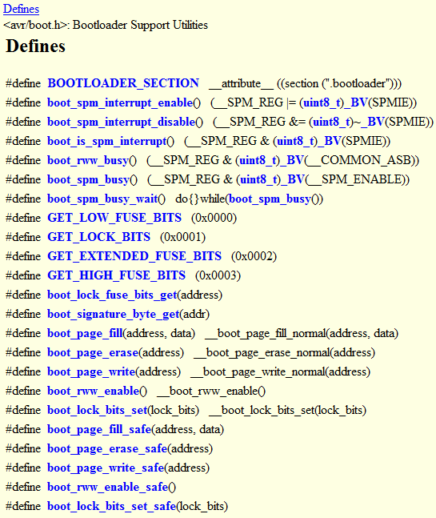
AVR libc: Bootloader Support Utilities

Slide 32


<avr/boot.h>

Slide 33
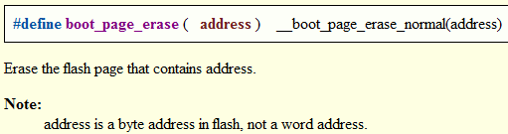
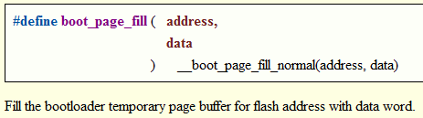

<avr/boot.h>

Slide 34
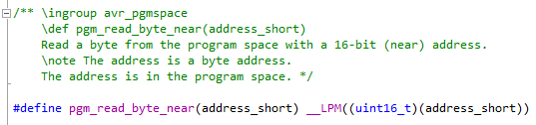
<avr/pgmspace.h>

Slide 35
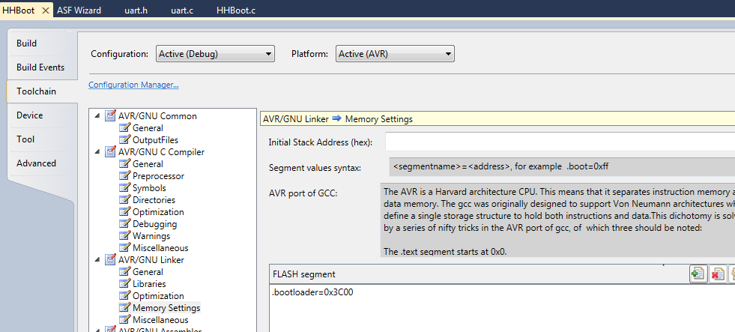
Locating the bootloader code

Slide 36
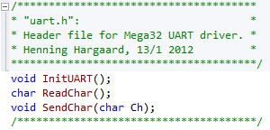
Minimum UART driver (header file)

Slide 37
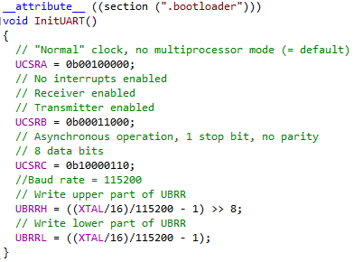
Locating the UART driver

Slide 38
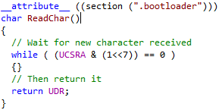
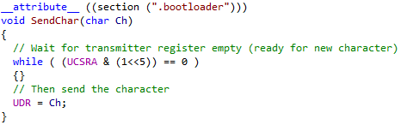
Locating the UART driver

Slide 39
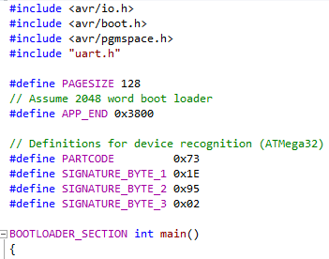
Locating the Boot Loader main()

Slide 40
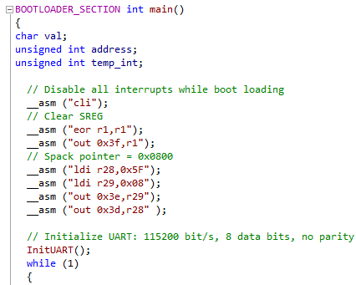
Boot Loader basic init code

Slide 41
Common AVR protokols
STK500, version 1
Used by many Arduino Bootloaders.
STK500, version 2
Used by Arduino Mega2560 + other Arduino board Bootloaders.
Protokol desciption can be found at AMS Blackboard.

Slide 42
Programmer: AVRdude
Great PROGRAM for interfacing MANY programmers and Bootloaders with MANY protokols and MANY AVR controllers.
Open source project.
Command line driven, but a good version with Windows GUI is available at AMS Blackboard.

Slide 43
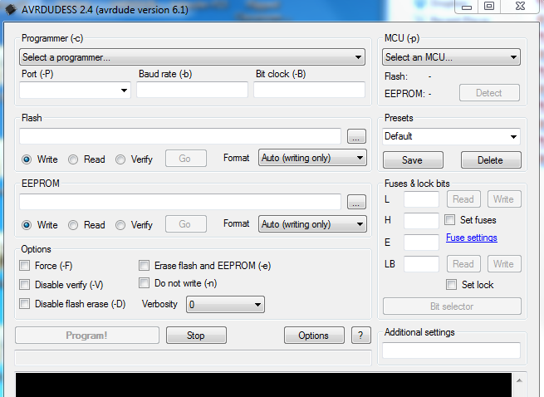
AVRdude + Windows GUI

Slide 44

End of lesson 4

